Slide 1
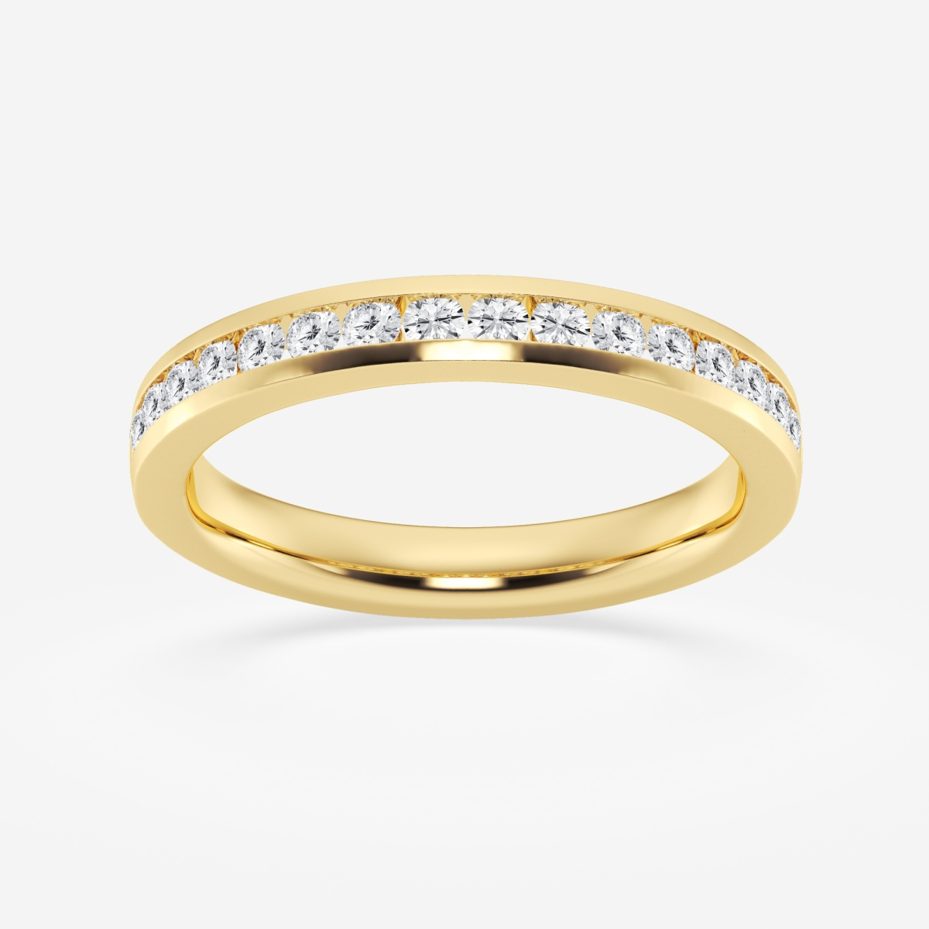
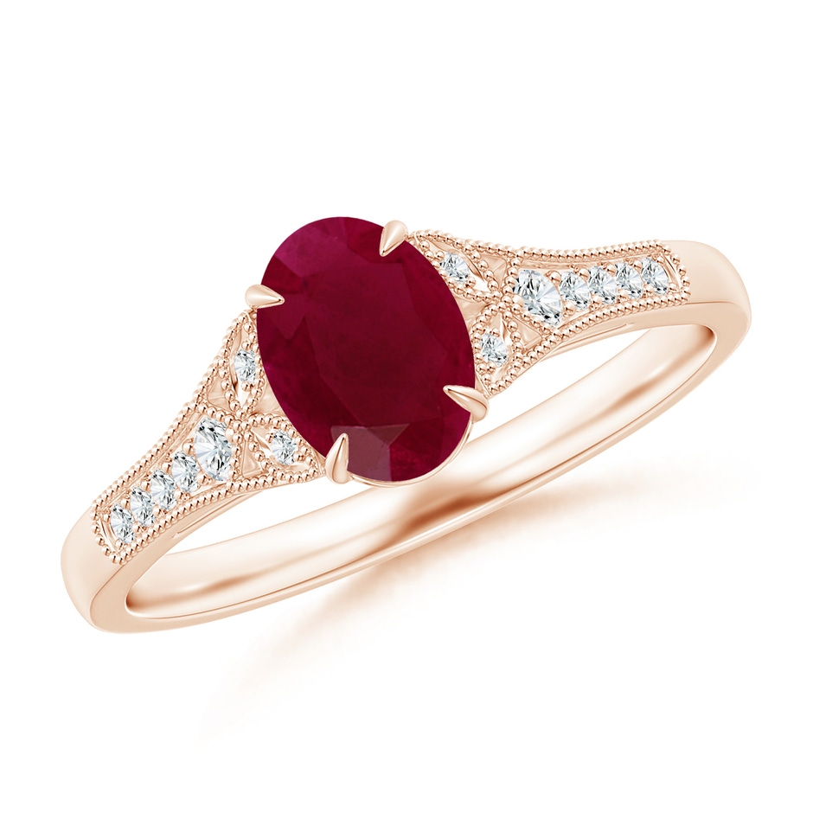
Jewelry Selling Website and Company
By: Kevin Zhang

Slide 2
Objective and Solution Approach
The objective is to start a jewelry dealing business that buys, sells, or trades expensive jewelry
Jewelry Trading Website and Company Business Plan
Overview of Scrum Methodology
User Roles and Stories
Simple Model
Definition of Done
Initial Prioritizing, Estimating, Planning
Product and Sprint Backlog
Burndown Chart
Sprint Reviews and Retrospectives
Release Planning
Sprint 1
Begin Development of Homepage of Website
Sprint 2
Continue Development of Homepage of Website
Sprint 3
About Webpage
Market Analysis, Organization and Management, Service
Sprint 4
Web Hosting Service
Web Development IDE Platform
Contact Us Webpage
Sprint 5
Submit Inquiry Page
Advertisements
Sprint 6
Sales Webpage
Menu Toolbar for all Webpages
Sprint 7
Document Remaining Backlog
Proposed Additional Features
Finish Remaining Business Plan Sections

Slide 3
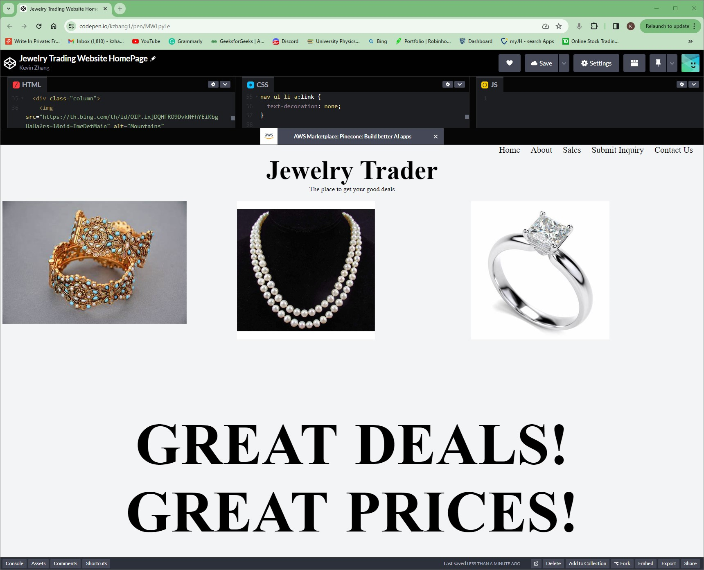
Jewelry Website Homepage
https://codepen.io/kzhang1/pen/MWLpyLe
This still needs better and more interactive graphics and design, but good enough for now

Slide 4
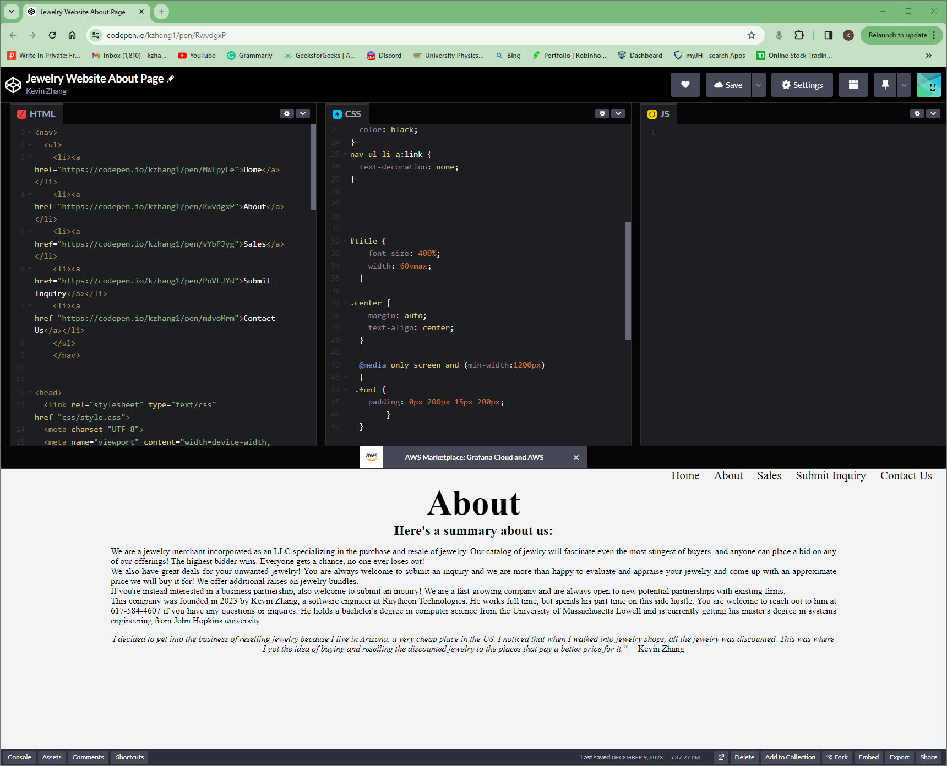
Jewelry Website About Page
https://codepen.io/kzhang1/pen/RwvdgxP
Still needs interactive graphics, but pretty much done!

Slide 5
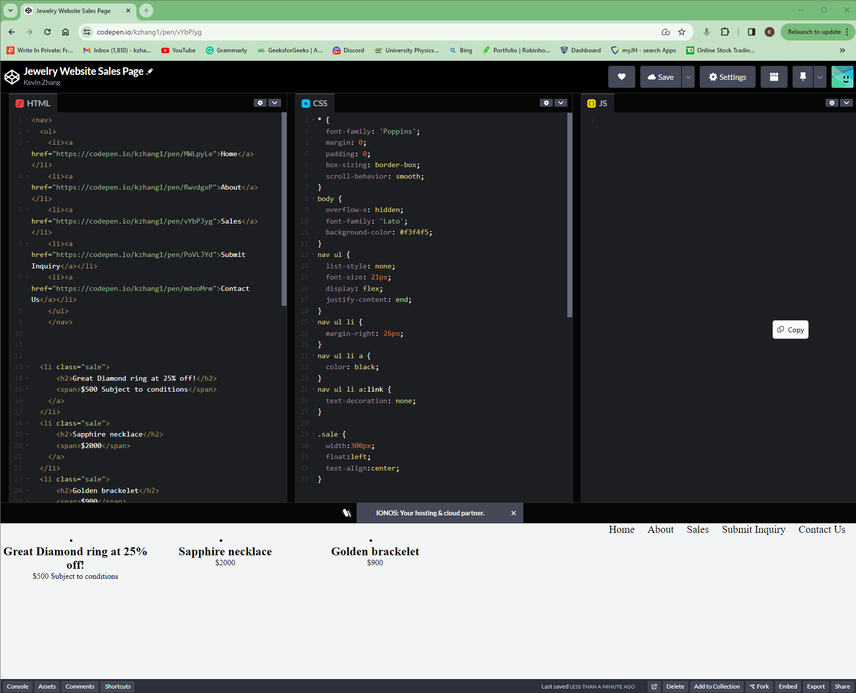
Jewelry Website Sales Page
https://codepen.io/kzhang1/pen/vYbPJyg
Was not able to finish this webpage because it was a tricky web design to figure out. In the future, I might consider using a database to store all the jewelry for sale information and the webpage will just pull the data from the database

Slide 6
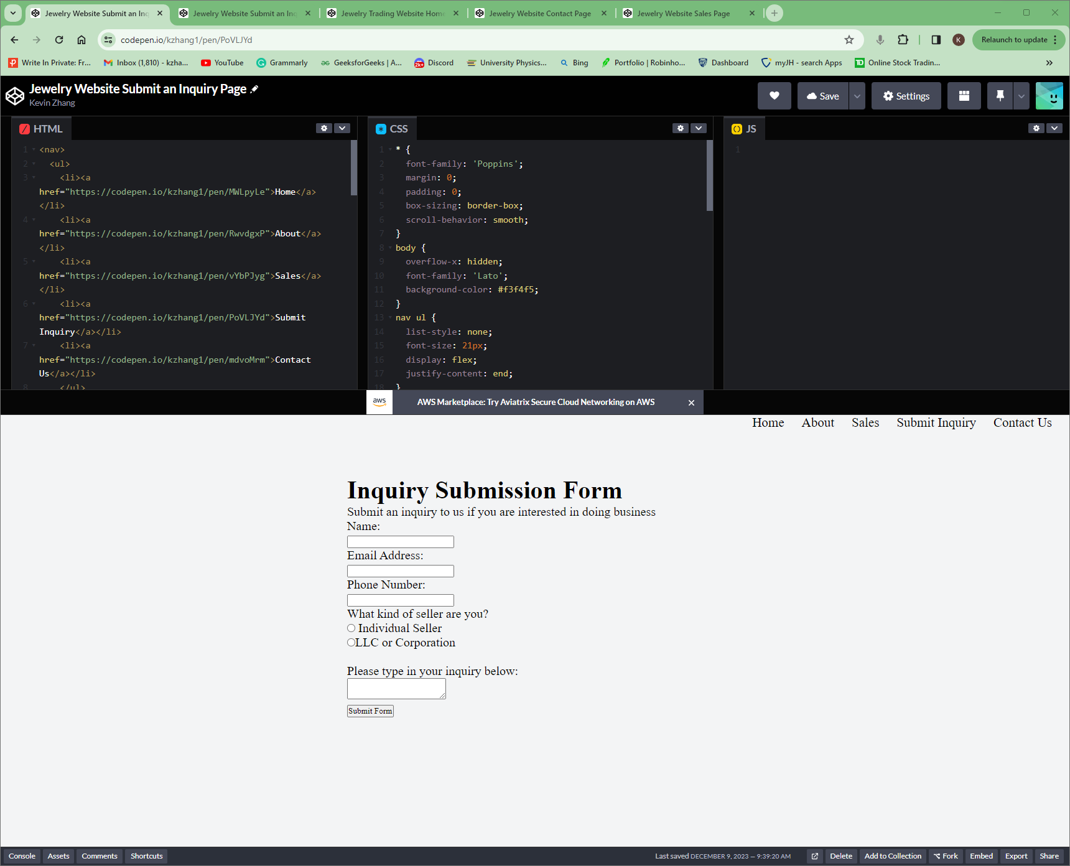
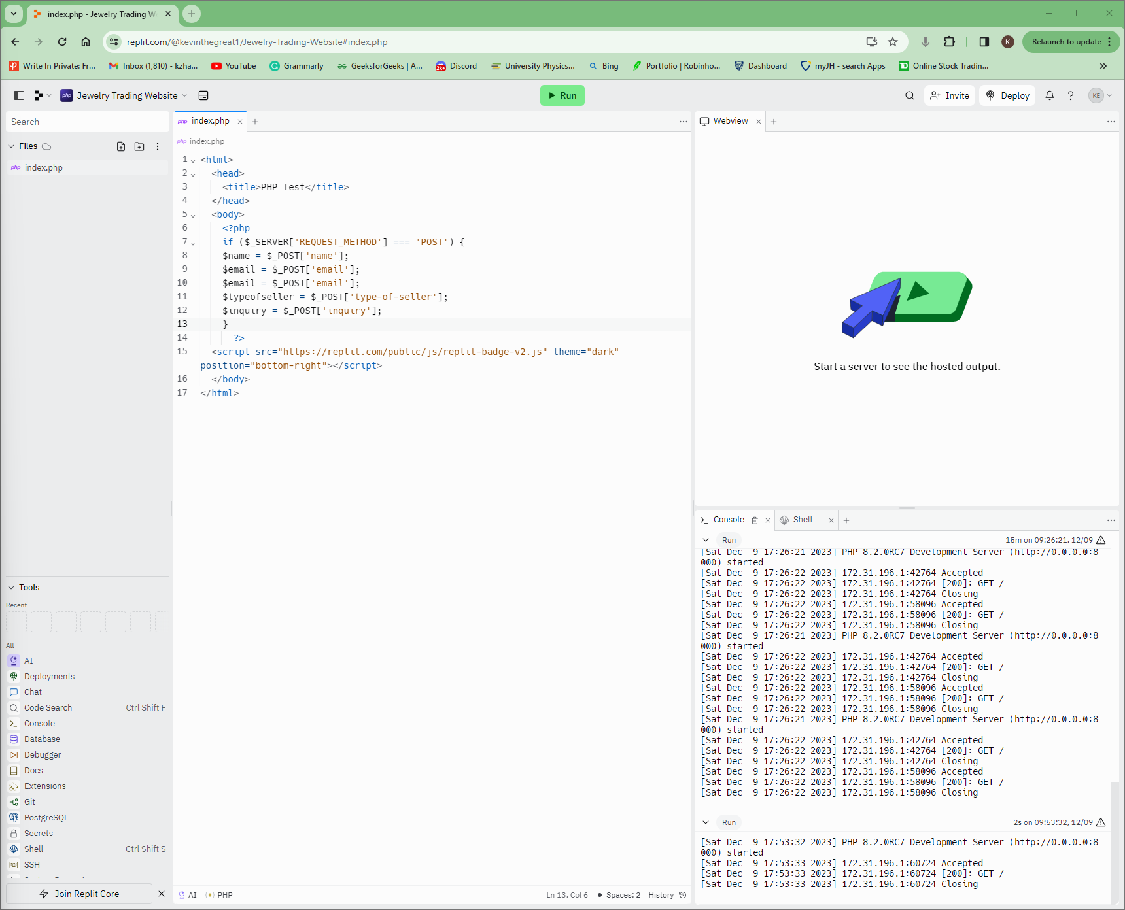
Jewelry Website Submit Inquiry Page
The PHP server that is supposed to receive the inquiry submission is not working yet
https://codepen.io/kzhang1/pen/PoVLJYd
https://replit.com/@kevinthegreat1/Jewelry-Trading-Website#index.php

Slide 7
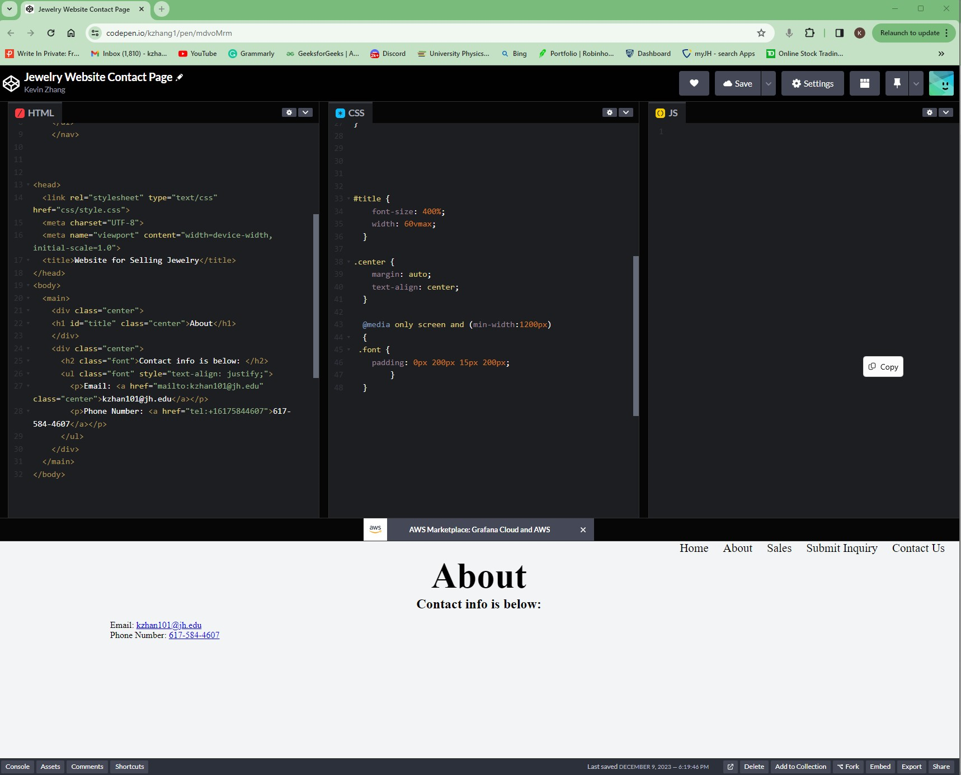
Jewelry Website Contact Us Page
https://codepen.io/kzhang1/pen/mdvoMrm
Better graphics is better, but this should do for now

Slide 8
Retrospective – Key Takeaways
Scrum
Prioritization, Estimation, and Team Velocity
Definition of Done
Burndown Chart
Test Driven Development
Jewelry Market Analysis
Web and Business Plan Development
Web Design
Server-Side Programming

Slide 9
Thank you!

